Slide 1
How To Persuade Casual Riders To Become Members
Created by: Yong Gao
Updated On: Dec 15, 2021

Slide 2
WHY & HOW
Members provide more profit than Casual Riders
The marketing department switch the focus to convert the casual riders to become annual members in order to generate more profit
Use internal last 12 months’ data to analyze how the annual members and causal riders use the bikes differently.
Develop a strategy to persuade the casual riders to buy memberships.

Slide 3
The Differences between the Casual Rider and Member
Average Minutes per Rides on Monthly Basis for last 12 months
Average Riding Time per ride during day of week for last 12 months
Total Number of Rides during day of week for last 12 months

Slide 4
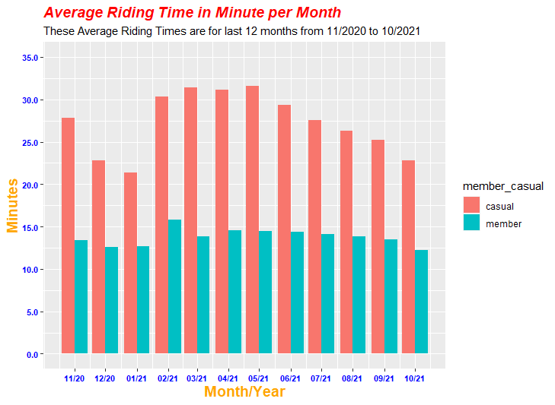
Average Minutes per Rides on Monthly Basis
Casual Riders’ average minutes per ride is longer than members.

Slide 5
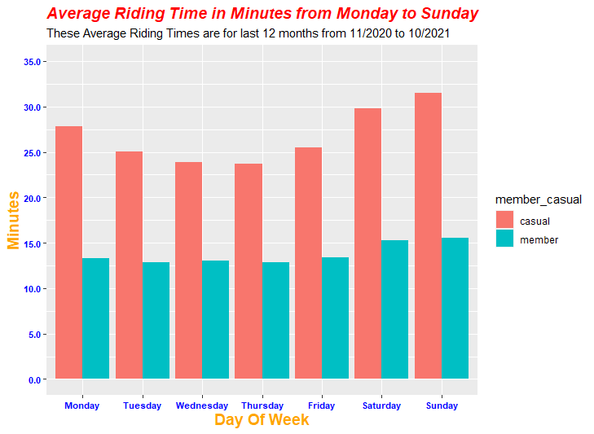
Average Riding Time per ride during day of week
Casual Riders spend significant more time per ride than member on every day of week.

Slide 6
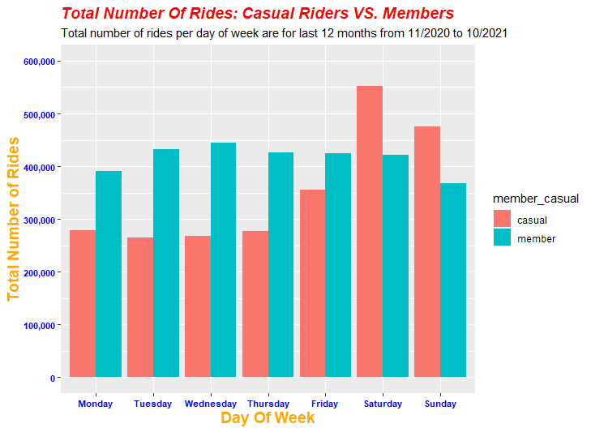
Total Number of Rides from during day of week
On weekend, the total number of casual rides are greater than members.
On weekday, the total number of casual rides are less than members

Slide 7
The Benefits To Become A Member
Save money and have member discounts to many city attractions.
Save time and avoid congested traffic
Save the planet without polluting the air

Slide 8
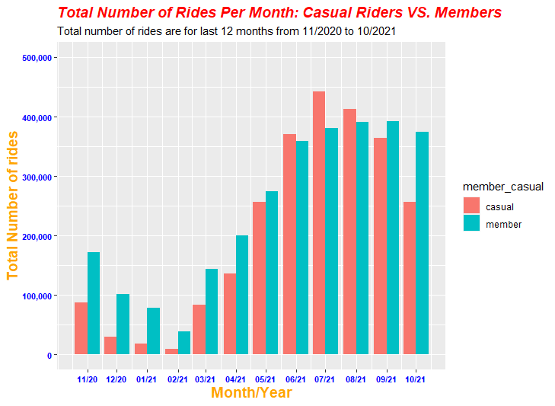
Using Digital Media Influences
From last 12 months, the total number of casual rides are increasing as same rate as members. All emails or cell phones number of them are collected.
we can send personalized activities, maps, contributions to climate change and members’ testimonies by emails and texts.
Use social medias to link with these casual riders, then to communicate and update any events and benefits by their interests.

